Slide 1
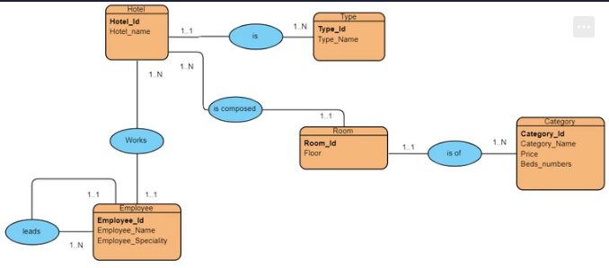
Hotel: (Hotel_id, Hotel_name)
Type: (Type_id, Type_Name)
Room: (Room_id, Floor)
Employee: (Employee_id, Employee_Name, Employee_Speciality)
Category: (category_id, category_name, price, beds_number)

